Slide 1



Slide 2
"Data-Driven Analysis of Tourist Attractions: Revenue, Accessibility, and Visitor Trends"
Presented By:
Md Sahabuddin
Roll: 20
Batch- 63

Slide 3

Abstract
This project analyzes the tourism sector in Bangladesh by evaluating key data points from various tourist spots.
The report serves as a comprehensive guide for policymakers and stakeholders to drive sustainable growth in Bangladesh's tourism industry.

Slide 4
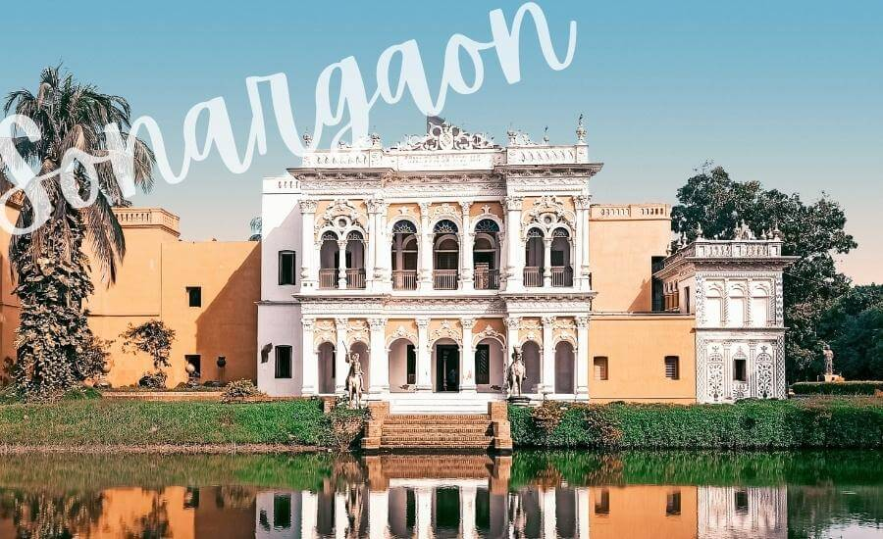
Introduction
Tourism plays a vital role in Bangladesh's economy, contributing significantly to revenue generation and cultural exchange (Bangladesh Tourism Board Report, 2023) . This report aims to provide a detailed analysis of various tourist destinations across the country, focusing on revenue trends, visitor statistics, accessibility, and seasonal impacts.
The objective of this report is to assess the effectiveness of the current tourism infrastructure, highlight areas for improvement, and propose strategic recommendations to enhance the visitor experience
The findings presented here offer valuable insights for policy formulation and investment planning in Bangladesh's growing tourism sector.

Slide 5
Research Methodology
Data Collection
Data preparation
Comparative Analysis
Tools and techniques
Limitations

Slide 6







Summary of Tourist Spots Data
Locations
Revenue and Visitors
Categories
Development Costs
Ticket Prices
Peak Seasons
Accessibility

Slide 7
Key Findings
Top Tourist Spots
Kuakata Beach: Highest revenue generator (Tk 100 million annually, 40,000 monthly visitors).
Lalbagh Fort & Jhulonto Bridge: Popular cultural and adventure destinations.
Revenue & Accessibility
Most attractions have low or no entry fees.
Majority of spots have facilities for disabled visitors
Seasonal Trends
Winter & Spring: Peak seasons for tourism.
Correlation Between Ticket Price and Development Cost.
Comparison
Devlopment
And Revenue
A ratio greater than 1 means revenue exceeds cost; less than 1 means revenue is lower than cost.
The strong correlation (R=0.9577) suggests that continued investment in tourism infrastructure may further increase government revenue
Correlation
The correlation value of 0.04379 indicates an extremely weak or negligible linear relationship between development cost and ticket price. This suggests that the development cost of a tourist attraction does not have a significant direct influence on its ticket price.

Slide 8
The sights built in the 14th century are very popular among tourists. We can understand this by looking at this pie chart.

Slide 9
This chart shows disabled accessibility for each division’s tourist spots.

Slide 10

Conclusion
Bangladesh’s diverse tourist attractions offer significant cultural, natural, and economic value. Strategic improvements in revenue management, accessibility, and promotional efforts can further elevate the tourism sector. This report serves as a foundation for informed decision-making to foster sustainable growth.

Slide 11


